Slide 1
Finance Committee Meeting
April 21, 2022

Slide 2
Agenda
Board Agenda Items
Approve MBIT 2022-2023 Proposed Budget Resolution
Approve FSMC Contract Renewal for 2022-2023
Approve the Giant Feeding School Kids Program Award
Approve Food Service Equipment Purchase
Approve Van Bid
Discussion Items
2022-2023 Budget Update
Wellness Policy Update
CRN/CRS Piano Purchase

Slide 3
Approve MBIT 2022-2023 Proposed Budget Resolution
Finance Committee Meeting
April 21, 2022

Slide 4
Highlights: MBIT 2022-2023 Budget
Minimal impact to CRSD General Fund Budget (small reduction)
Contemplates current borrowing/debt service (for MBIT projects)
More detail forthcoming as a result of enrollment challenges.
Board can wait until June to approve. This is the normal time of year to consider MBIT budget.

Slide 5
Approve FSMC Contract Renewal for 2022-2023
Finance Committee Meeting
April 21, 2022

Slide 6
Food Service Management Company-Chartwells
Annual renewal (year 3 of 5)
Guaranteed return of $75,000
Based on actual spend/reimbursement.
Application based on non-continuance of Federal Meal Waivers.
Audit completed in March 2022. Waiting on results/corrective actions.

Slide 7
Approval: Giant Feeding School Kids Program Award
Finance Committee Meeting
April 21, 2022

Slide 8
Giant Grocery Store-grant acceptance
“Feeding Kids Initiative”
$7900.00 received to offset unpaid lunch debt.
Cannot be used to supplant regular Food Service spending.

Slide 9
Food Service Equipment Purchase
Finance Committee Meeting
April 21, 2022

Slide 10
Food service equipment
Evaluation of existing equipment made
Using existing food service surplus funds (not General Fund)
Needs compiled; 4 quotes received
Range of quotes: $113,000-150,000

Slide 11
Food service equipment
Council Rock School District
Equipment Upgrades
 | Equipment | School | Quantity
 | Food Slicer | North | 2
 | Food Slicer | South | 1
 | Juice Extractor | North | 1
 | Cutter Mixers-Robot Coupe | North | 1
 | Electric Stove | North | 1
 | Griddle Countertop | North | 1
 | Planetary Mixer | North | 1
 | Blender Bar | North | 1
 | Dishwasher | North | 1
 | Heated Holding Cabinet | North | 1
 | Heated Holding Cabinet | South | 2
 | Heated Holding Cabinet | Newtown Middle | 1
Notes:
Will add detail of costs per once availability and delivery date is confirmed from low bidder.

Slide 12
Van purchase
Finance Committee Meeting
April 21, 2022

Slide 13
Van purchase
Per March FINCOM discussion, Transportation and SE Teams determined additional need for TWO additional vans.
Purchased with District funds; reimbursed through ACCESS funding.
Several quotes received..

Slide 14
Van purchase
Tally of van bids

Slide 15
Discussion Item: 22-23 Budget
Finance Committee Meeting
April 21, 2022

Slide 16
Historical Staffing Overview
2016-2017 Reductions of $5,139,332
Reductions of: 1 Administrator, 18.3 Professional Staff FTES and 16.4 Support Staff FTEs. Including the elimination of the Federal Programs Coordinator, reduction of 1.0 Librarian.
Reductions in Software, repairs, equipment purchases, elementary after school sports, music equipment, textbooks, and elimination of 4:00pm buses.
7% reductions in: all building allocations, and athletic budgets

Slide 17
Staffing Budget Projection 2022-2023

Slide 18
Historical Staffing Additions & Reductions
The following slides include additions/reductions made during the annual budget process, additions through position authorizations, attrition, shifts in elementary enrollment and high school course selections.

Slide 19
Historical Staffing Additions & Reductions
School Year | FTEs Added | Positions | FTE Reductions | Positions
2013-2014 | 17 .8 8 2 | Speech & Language Pathologists (from the BCIU) Social Worker (from Lenape Valley) New Teacher Assistants New Security Officers
2014-2015 | 2 1 2 | Cares Counselors Math Specialist Special Education Teachers – Achieve
2015-2016 | .4 1 .4 2.25 | Behavior Analyst Teacher Assistant Administrative Assistant, HR Clerical Assistants | 1 | Supervisor, Grounds
2016-2017 | 8 2 | Teacher Assistants Staff Nurses | 1.5 18.3 16.4 | Administrative, Supvr. Special Ed/.5 Business Adm. Professionals Support Staff

Slide 20
Historical Staffing Additions & Reductions
School Year | FTEs Added | Positions | FTE Reductions | Positions
2017-2018 | 4 2 1 2 4 2 1.2 .2 2 | Special Education Teachers Transportation Specialists Communications Specialist Tech Integration Specialists Bus Monitors Clerical Assistant (part time) ELD Teacher Math Elementary Sections | .6 | ELD Teacher
2018-2019 | 5.6 5 1.2 4 1 | Special Education Teachers Teacher Assistants Clerical Assistants (part time) Tech Integration Specialists Administrator, Special Ed Suprv. | 11.5 5 2 | Professionals Support Tech Specialists
2019-2020 | .4 2 | Reading Specialist Tech Integration Specialists
2020-2021 | 3 .3 .21 1 1 | Elementary Counselors Math Special Ed BCBA ELD Teacher

Slide 21
Historical Staffing Additions & Reductions
School Year | FTEs Added | Positions | FTE Reduction | Positions
2021-2022 | 1 | .6 CRS Increases 1 Special ED (added June) | 1 1 1 | ELD Teacher (removed from budget) Loss of Elementary Sections Health & PE
2022-2023 | 3.1 | Additional Sections @ CRN | 1.6 | Loss of Elementary Sections

Slide 22
Attrition
School Year | Professional FTEs | Support FTEs | Administrator FTEs
June 2013 | 31.8 | 18.45 | 2
June 2014 | 29 | 21.8 | 1
June 2015 | 38 | 13.9 | 3
June 2016 | 26 | 24 | 5
June 2017 | 34.7 | 26.2 | 0
June 2018 | 19.8 | 34.23 | 1
June 2019 | 25 | 40.2 | 0
June 2020 | 34.5 | 36.7 | 1
June 2021 | 45 | 49.6 | 3
June 2022 | 27 | 61 | 8

Slide 23
Comparably Sized Districts Staffing
Enrollment | District | Central Office Administrators | School Administrators | Professionals
10,454 | Council Rock | 19 | 24 | 1042
9,703 | Parkland SD | 28 | 21 | 880
9,673 | Pennsbury SD | 26 | 26 | 1006
9,292 | Neshaminy SD | 37 | 20 | 698
11,975 | Hazeltown Area | 28 | 36 | 891
12,095 | West Chester Area | 31 | 29 | 1297
12,224 | Central Dauphin | 27 | 38 | 1136
12,783 | North Penn | 32 | 36 | 1251
The professional numbers are elevated from budget FTEs as PDE info (source) includes long term substitutes

Slide 24
Administrative Recommendation
2022-2023 Budget

Slide 25
Highlights
REVENUE-Taxes and Reimbursements
EXPENSES: What’s included?
Admin Recommendation:
Increase levy 2.4% (IFO minus 1%)
Boosted projections on EIT, BEF, SEF
Improved reimbursement on Transportation
Increases to Charter School
Transportation contract final
Projected Salary/PSERS increases
Initiatives to address student need (learning loss, ELL’s, SE, Gifted)
Curriculum adoptions
Security upgrades

Slide 26
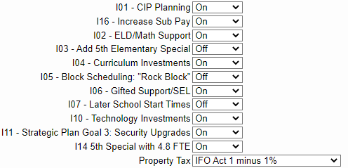
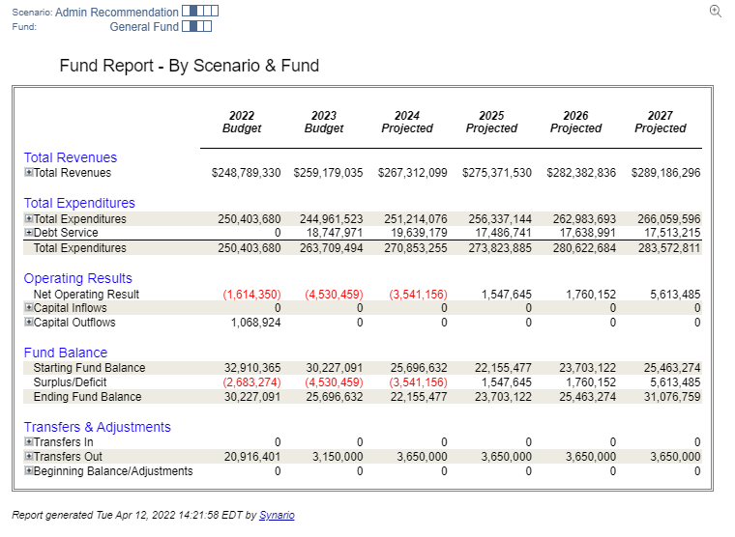
Administration Recommendation-@ 2.4% Tax Increase (IFO-1%)

Slide 27
Highlights: What does CR get for 2.4%?
Staffing
Program
Gifted Teacher
SE Support (IA’s/Teachers)
Math Specialist
STEAM Teachers
Considers keeping sub pay at current levels
Security Upgrades:
Access Card Readers
Cameras
Upgraded software
Curriculum upgrades
Initiatives to address student need (learning loss, ELL’s, SE, Gifted)
Curriculum adoptions
Security upgrades

Slide 28
Revenue Budget: How did we get here?
Act 511 Taxes:
RE Transfer Taxes: 1% of sale price (.5% to CRSD; .5% to Bucks County) +$1.0mm
Earned Income Taxes: 1% of earned income (reported to IRS) +$2.0mm
Local Property Taxes:
Based on Assessed Value of property (not sale price)
Updated values released before May meeting from County.
State Subsidies:
Basic Ed: Formula based on student count and other economic factors
Special Ed: Formula based on student count and other economic factors
State Reimbursements
PSERS: 50% of total payments in salary-will change based on attrition/initiatives
Social Security: 50% of total payments in salary-will change based on attrition/initiatives
Transportation: varying percentage of certain route costs +$400k
Lease/Debt Service: PlanCon K; future debt contemplation
Federal Subsidies
IDEA
ESSA (Title 1)
ARP/ESSER

Slide 29
Revenue Budget: Next Steps?
Build endorsed initiatives into budget
Build out attrition (salary breakage)
Final review of 300’s-900’s has situation changed?

Slide 30
Budget Approval Timeline: Next steps
May 5: Adopt Proposed Final Budget
June 16: Adopt Final Budget/Enact Tax Levy

